Slide 1
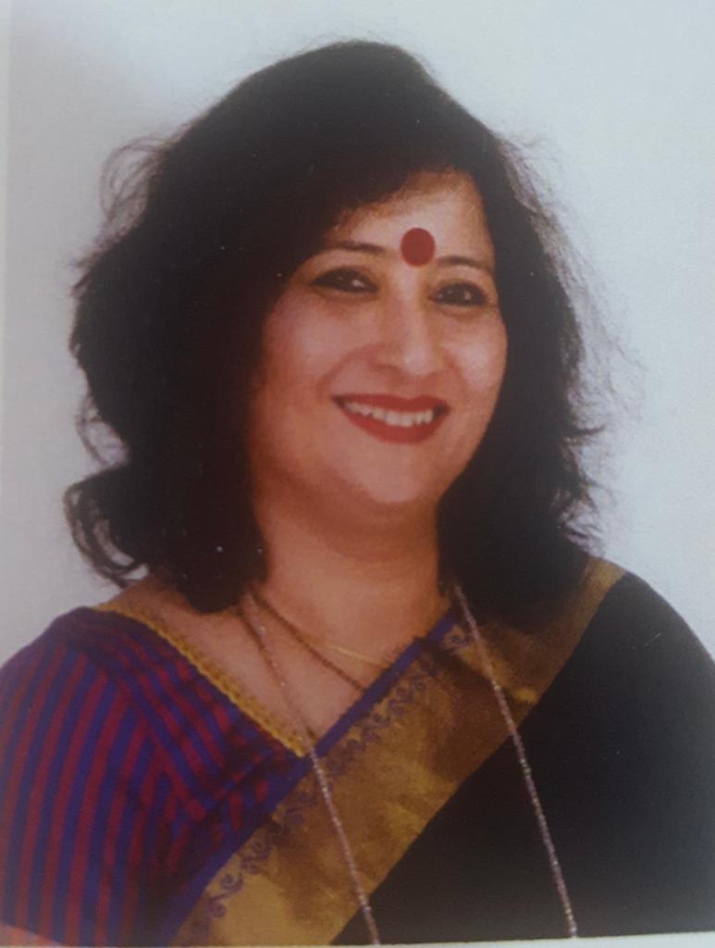
WOMEN DEVELOPMENT CELL HOSTS
NATIONAL WEBINAR
ON
ENCOMPASSING GENDER
Best College(2013-14)University of Mumbai
Resource Person
Dr.Leena Pimpley
Our Patrons
Dr. R. Varadarajan Dr. Balasubramanian.V
Founder-President Director
NES-SVB GROUP OF INSTITUTIONS NES-SVB GROUP OF INSTITUTIONS
Advisory Committee
Dr.Mary Vimochana( Principal)
Dr. Vinita Dhulia( Vice-Principal)
Dr.Lata Swaminathan(Vice-Principal)
Click here to register
&
Join us
Date: 14.08.2020
Time: 11.00 am
Contact persons
Dr. Meenakshi Kumaraguru (Convenor)-9869810893
Dr. Jennifer Coutinho- 9820527961
Dr.Deepa.C- 9702041910

Slide 2
WOMEN DEVELOPMENT CELL HOSTS
NATIONAL WEBINAR
ON
ENCOMPASSING GENDER
BHANDUP(W), MUMBAI-400078
Best College(2013-14)University of Mumbai
Resource Person
Dr.Leena Pimpley
Our Patrons
Dr. R. Varadarajan Dr. Balasubramanian.V
Founder-President Director
NES-SVB GROUP OF INSTITUTIONS NES-SVB GROUP OF INSTITUTIONS
Advisory Committee
Dr.Mary Vimochana( Principal)
Dr. Vinita Dhulia( Vice-Principal)
Dr.Lata Swaminathan(Vice-Principal)
Click here to register
&
Join us
Date: 14.08.2020
Time: 11.00 am
Contact persons
Dr. Meenakshi Kumaraguru (Convenor)-9869810893
Dr. Jennifer Coutinho- 9820527961
Dr.Deepa.C- 9702041910

